Slide 1
Urine drug testing and the roles of a Medical Review Officer
Matt Noble, MD MPH
Medical Toxicology Fellow
Certified MRO

Slide 2
Outline
What is a Medical Review Officer?
Who regulates testing? Who gets tested?
Urine collection procedure
Lab interpretation
The MRO verification process
On the horizon of drug testing

Slide 3
Outline
What is a Medical Review Officer?
Who regulates testing? Who gets tested?
Urine collection procedure
Lab interpretation
The MRO verification process
On the horizon of drug testing

Slide 4
MRO responsibilities
Interpret forensic drug testing results within the context of a regulatory framework
  Dept of Transportation 49 CFR Part 40
Interact with the donor to discuss results and facilitate appropriate actions and requests
  Confirm or deny legitimate medical reasons for positive results

Slide 5
Outline
What is a Medical Review Officer?
Who regulates testing? Who gets tested?
Urine collection procedure
Lab interpretation
The MRO verification process
On the horizon of drug testing

Slide 6
Regulatory framework
Department of Health and Human Services (DHHS)
Department of Transportation (DOT)
Federal Motor Carrier Safety Administration (FMCSA)
Federal Aviation Administration (FAA)
Federal Railroad Administration (FRA)
Federal Transit Administration (FTA)
Pipeline and Hazardous Material Safety Administration (PHMSA)
United States Coast Guard (USCG)
Nuclear Regulatory Commission (NRC)

Slide 7
Regulatory framework
DOT’s Office of Drug and Alcohol Policy and Compliance (ODAPC) = oversight
DHHS = scientific rationale
Safety-sensitive transportation agencies
FMCSA, FRA, FTA, FAA, PHMSA
USCG
NRC
~ 5 million employees (FMCSA=80%)

Slide 8
Reasons to be tested
Pre-employment (PE)**
Random (RA)
Reasonable suspicion (RS)
Post-accident (PA)
Return to duty (RTD)**
Follow-up (FUP)**
**requires “negative” result

Slide 9
Outline
What is a Medical Review Officer?
Who regulates testing? Who gets tested?
Urine collection procedure
Lab interpretation
The MRO verification process
On the horizon of drug testing

Slide 10
Specimens
Urine
Hair
Nail
Saliva
Breath (alcohol)

Slide 11
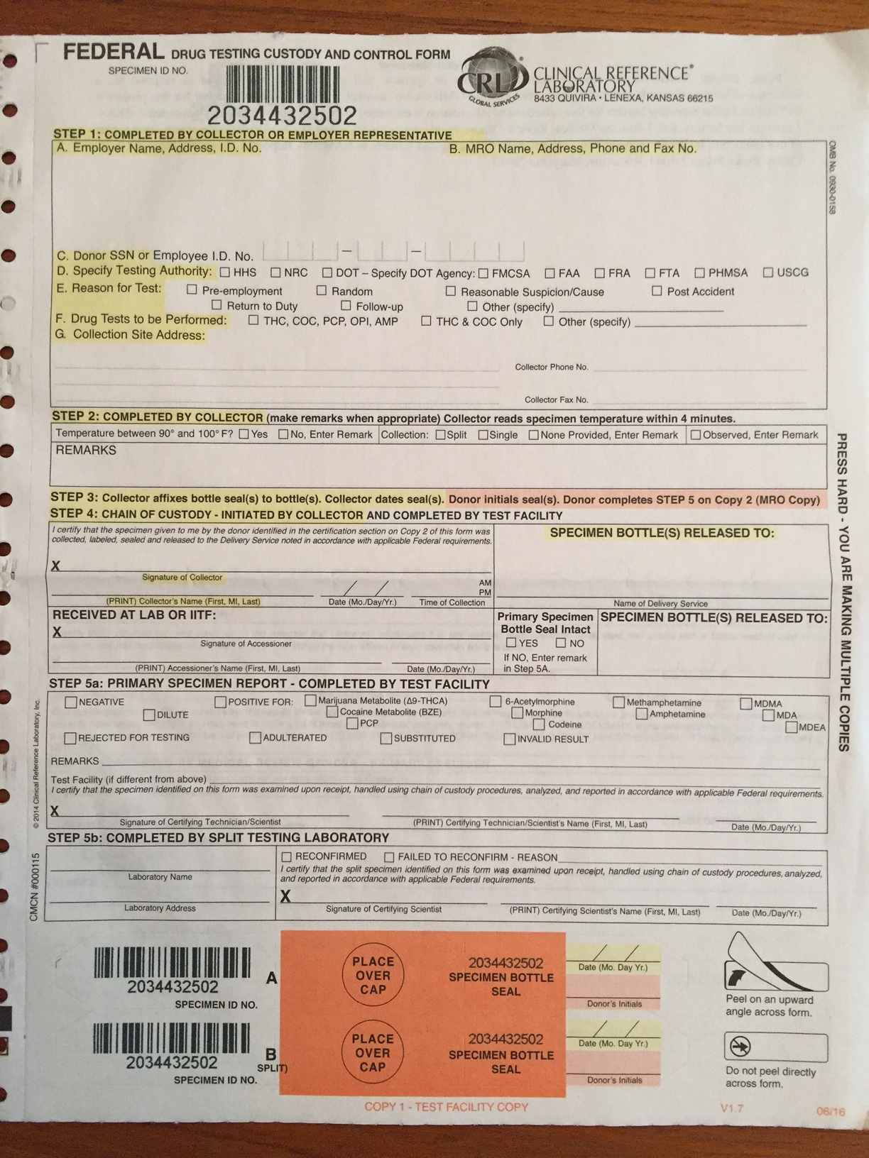
Urine collection
Standard Federal Drug Testing Custody and Control Form (CCF)

Slide 12
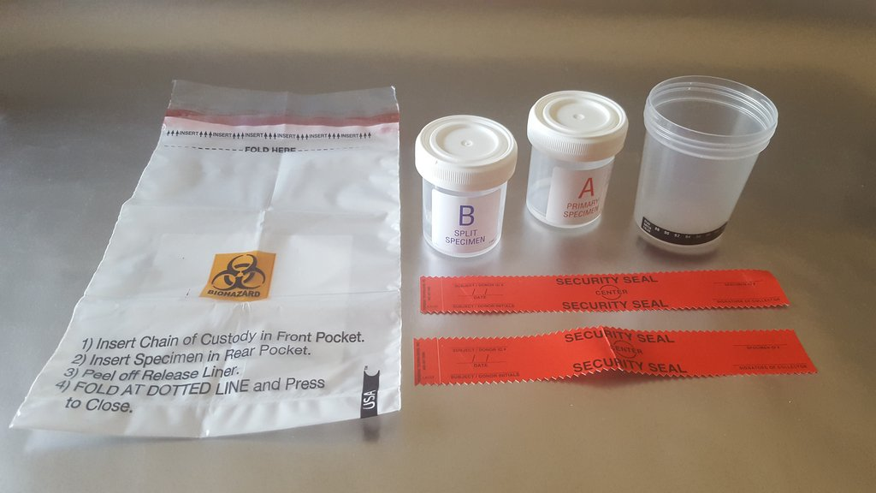
Urine collection
Standard collection kit

Slide 13
Urine collection
Collector must meet training requirements
“knowledgeable of” process per DOT regulations
“instructed on” how to collect (trained)
demonstrates proficiency (5 consecutive error-free mock collections)
Training occurs:
prior to being certified
every 5 years
after any errors

Slide 14
Urine collection
Approved collection site
Single-toilet room is preferred
donor has privacy (full-length door)
Multi-stall room if necessary
donor has visual privacy (partial-length door)
may be monitored (in bathroom, not in stall)
“Integrity of collection”
bluing in toilet, tape tank, remove trash, etc.

Slide 15
Urine collection
Collector explains procedure and completes Step 1 of CCF, donor washes hands
“Failure to cooperate is a refusal to test”
donor fails to wash hands,
admits to adulterating/substituting specimen,
found to have device
“You may not leave before I excuse you”
Selection of kit, by collector or donor, is the point of no return

Slide 16
Urine collection
Donor provides at least 45 mL
Collector:
notes temperature,
splits sample (30ml to bottle A, 15ml to bottle B), and
completes Step 2 of CCF

Slide 17
“Shy bladder”
Donor unable to provide sufficient sample volume on first attempt
First specimen is discarded
Donor is given up to 3 hours and 40 oz of fluid to provide an adequate urine specimen
If donor unable to provide new sufficient sample, collector contacts employer representative
If donor is unwilling (ie, leaves) = refusal to test

Slide 18
Direct Observation collection
When directed by employer
Invalid result, canceled positive test, RTD or FUP tests
When determined by collector
Suspected tampering (abnormal temperature or odor/color)
ALWAYS by same gender observer
Observer does NOT have to be a trained collector
If employee declines to allow observed collection = refusal to test

Slide 19
Direct Observation procedure
Nothing except skin between navel and knees
Turning around one full turn
Donor may then return clothing to proper position prior to providing specimen

Slide 20
“Fatal” specimen flaws
Specimen IDs on bottle and form do not match
Specimen bottle seal broken
(may redesignate bottle B as bottle A)
Collector’s name and signature missing
Insufficient quantity of urine for analysis
(may redesignate bottle B as bottle A)
Flaw documented on form and report “rejected for testing” (NO attempt to test specimen)

Slide 21
“Correctable” flaws
Collector’s signature omitted
Form is expired
Flaw documented on form
CONTINUE testing process
Attempt to correct flaw (may be “rejected” if not successful)

Slide 22
Temperature not recorded
Neither a fatal nor a correctable flaw
CONTINUE testing process
Attempt to correct

Slide 23
Outline
What is a Medical Review Officer?
Who regulates testing? Who gets tested?
Urine collection procedure
Lab interpretation
The MRO verification process
On the horizon of drug testing

Slide 24
What drugs are tested?
Amphetamine: amphetamine, methamphetamine, MDMA, MDA, MDEA
Marijuana: THC-COOH
Opiates: 6-acetylmorphine, morphine, codeine
Cocaine: benzoylecgonine
PCP
→ Only 11 compounds are currently tested for

Slide 25
Possible lab results
Flawed (~2% rejection rate)
Invalid
Adulterated
Substituted
Positive
Negative

Slide 26
Tests
Immunoassay (for specific drug compounds)
Specimen Validity Testing
pH
creatinine
specific gravity
oxidation
visual inspection
color consistency (between bottles)

Slide 27
pH
Adulterated > 11.0
Invalid > 9.0 to ≤ 11.0
Normal 4.5 to 9.0
Invalid ≥ 3.0 to < 4.5
Adulterated 1.0 to <3.0
Minimum of 3 tests for abnormal pHs

Slide 28
Creatinine
2, 5, and 20 mg/dL are important values
Need specific gravity for interpretation

Slide 29
Creatinine and Specific Gravity
Dilution: lower than expected values for normal human urine
Substitution: values outside the physiologically possible range of human urine
Invalid: incongruent results

Slide 30
Confirmatory testing
Gas Chromatography–Mass Spectrometry (GC/MS) or Tandem Mass Spectrometry (MS/MS)
Used whenever initial immunoassay results are positive (over cutoff value) for any of the 11 tested compounds

Slide 31
Confirmatory testing
If initial immunoassay below cutoff = negative
If immunoassay at or above cutoff → confirmatory testing
If confirmatory testing below cutoff = negative
If confirmatory testing at or above cutoff = positive
Lab reports only “positive” or “negative,” without concentration (unless quantitative values requested)
Exception is morphine or codeine (MRO needs concentrations)

Slide 32
Dilute specimens
Definition: Cr between 2 and 20 mg/dL and SG is between 1.0010 and 1.0030
If positive (for drug), dilution irrelevant
If negative, further action based on how dilute
Cr between 2 and 5 mg/dL = recollection
Cr >5 mg/dL = employer discretion/policy

Slide 33
Invalid specimens
“Invalid” is a laboratory result
Will never be reported with a “negative” result
may accompany “positive,” “adulterated,” or “substituted” results
Reasons may include:
inconsistent Cr and SG results
abnormal pH
abnormal nitrite concentration
presence of chromium or halogen or glutaraldehyde or oxidant or surfactant

Slide 34
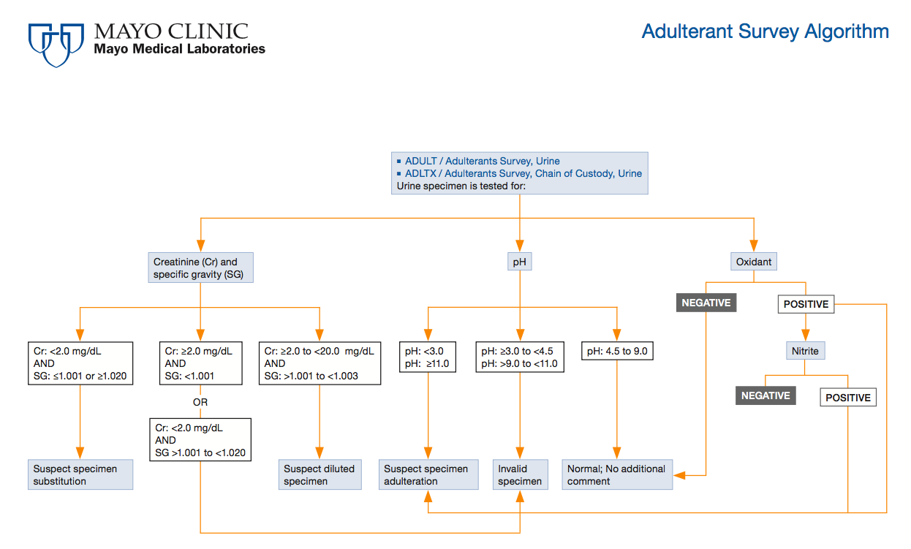

Slide 35
Outline
What is a Medical Review Officer?
Who regulates testing? Who gets tested?
Urine collection procedure
Lab interpretation
The MRO verification process
On the horizon of drug testing

Slide 36
MRO responsibilities
Interpret forensic drug testing results within the context of a regulatory framework
  Dept of Transportation 49 CFR Part 40
Interact with the donor to discuss results and facilitate appropriate actions and requests
  Confirm or deny legitimate medical reasons for positive results

Slide 37
“Legitimate medical explanations”
None for PCP or 6-acetylmorphine

Slide 38
What drugs are tested?
Amphetamine: amphetamine, methamphetamine, MDMA, MDA, MDEA
Marijuana: THC-COOH
Opiates: 6-acetylmorphine, morphine, codeine
Cocaine: benzoylecgonine
PCP

Slide 39
“Legitimate medical explanations”
None for PCP or 6-acetylmorphine
Otherwise, donor needs to have a prescription
+THC – Marinol or Sativex
+amphetamine – Adderall, Vyvanse
+methamphetamine – Didrex, Desoxyn, Selegiline
+cocaine – medical procedure (e.g., topical application)
Opiates are more complicated

Slide 40
What drugs are tested?
Amphetamine: amphetamine, methamphetamine, MDMA, MDA, MDEA
Marijuana: THC-COOH
Opiates: 6-acetylmorphine, morphine, codeine
Cocaine: benzoylecgonine
PCP

Slide 41
Positive opiate results
If ≥ 15,000 ng/mL, donor has burden of proof (e.g., Rx)
No “poppy seed” defense
If 2,000 – 15, 000 ng/mL, MRO has burden of proof
If donor has prescription → negative
If donor does not have Rx → requires “clinical evidence”
Opiate clinical exam (track marks, signs, etc)
If “evidence” → positive result
If no “evidence” → negative result

Slide 42
Outline
What is a Medical Review Officer?
Who regulates testing? Who gets tested?
Urine collection procedure
Lab interpretation
The MRO verification process
On the horizon of drug testing

Slide 43
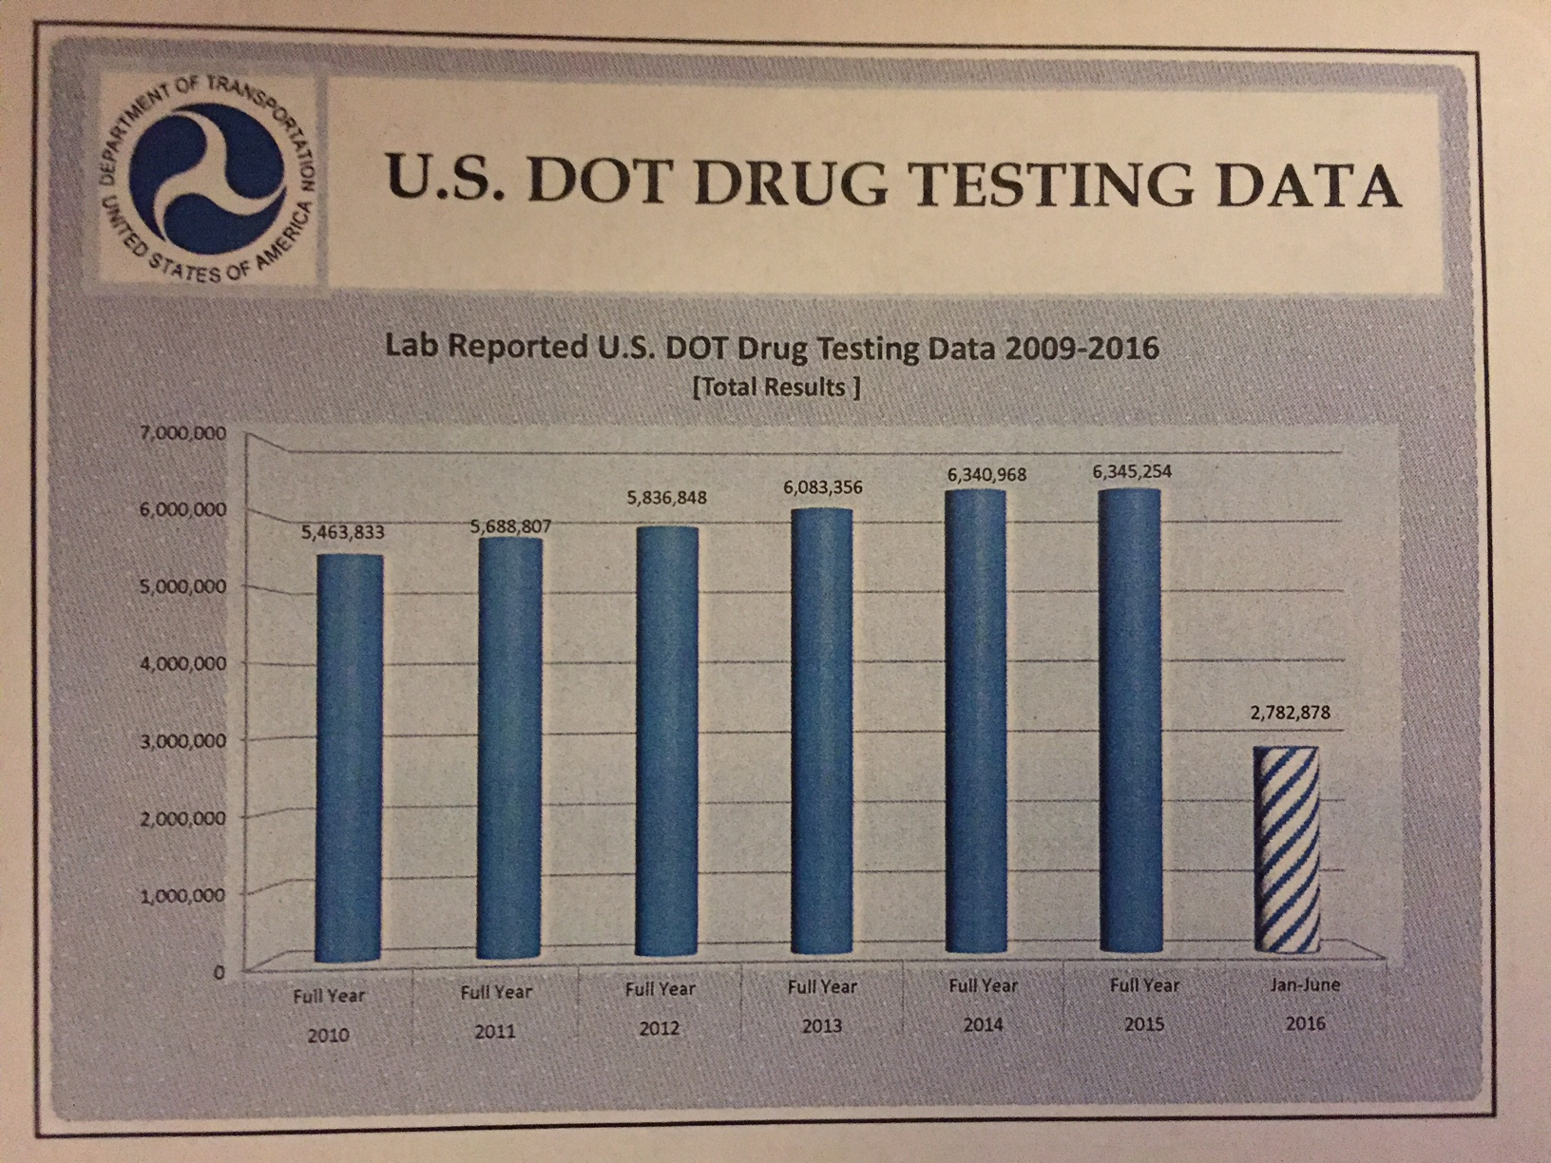
Current statistics

Slide 44
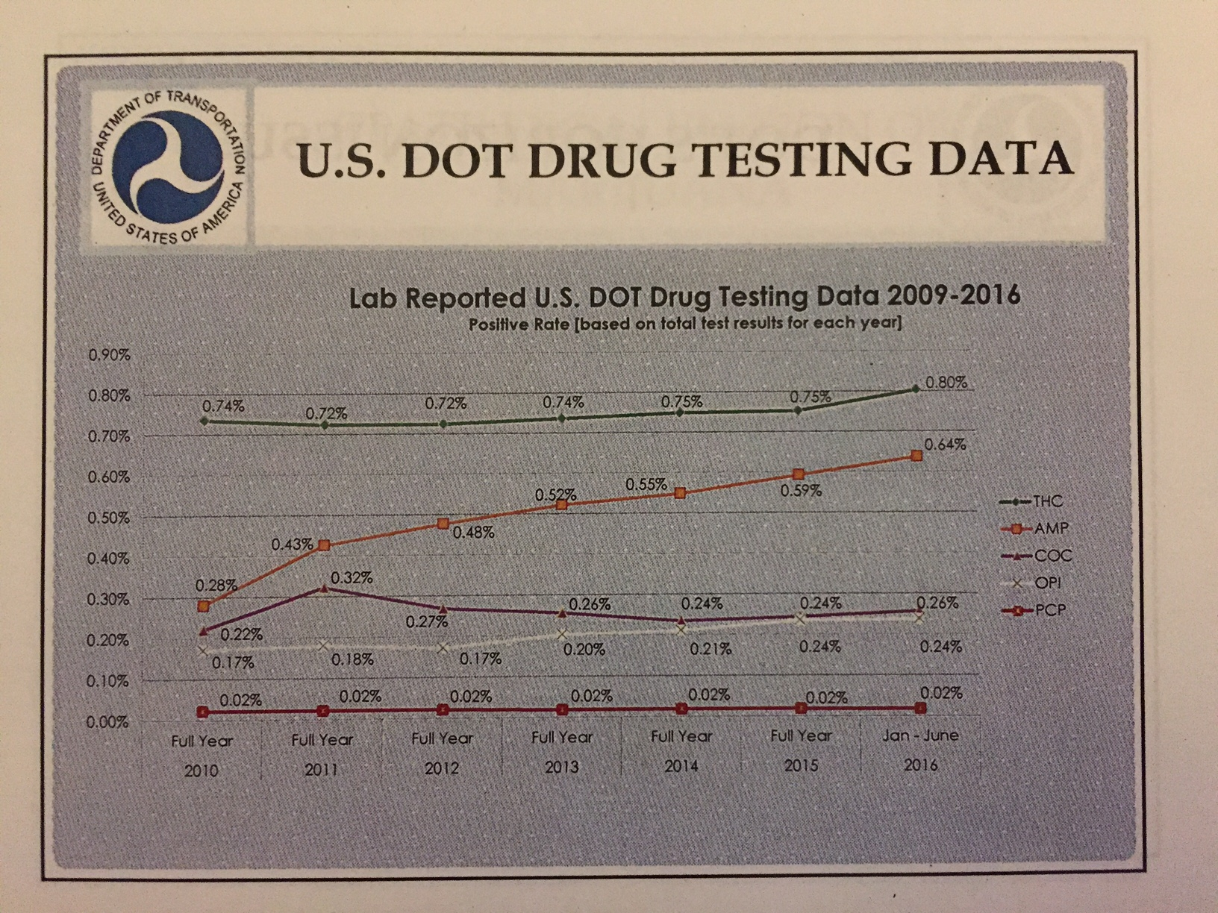
Current statistics

Slide 45
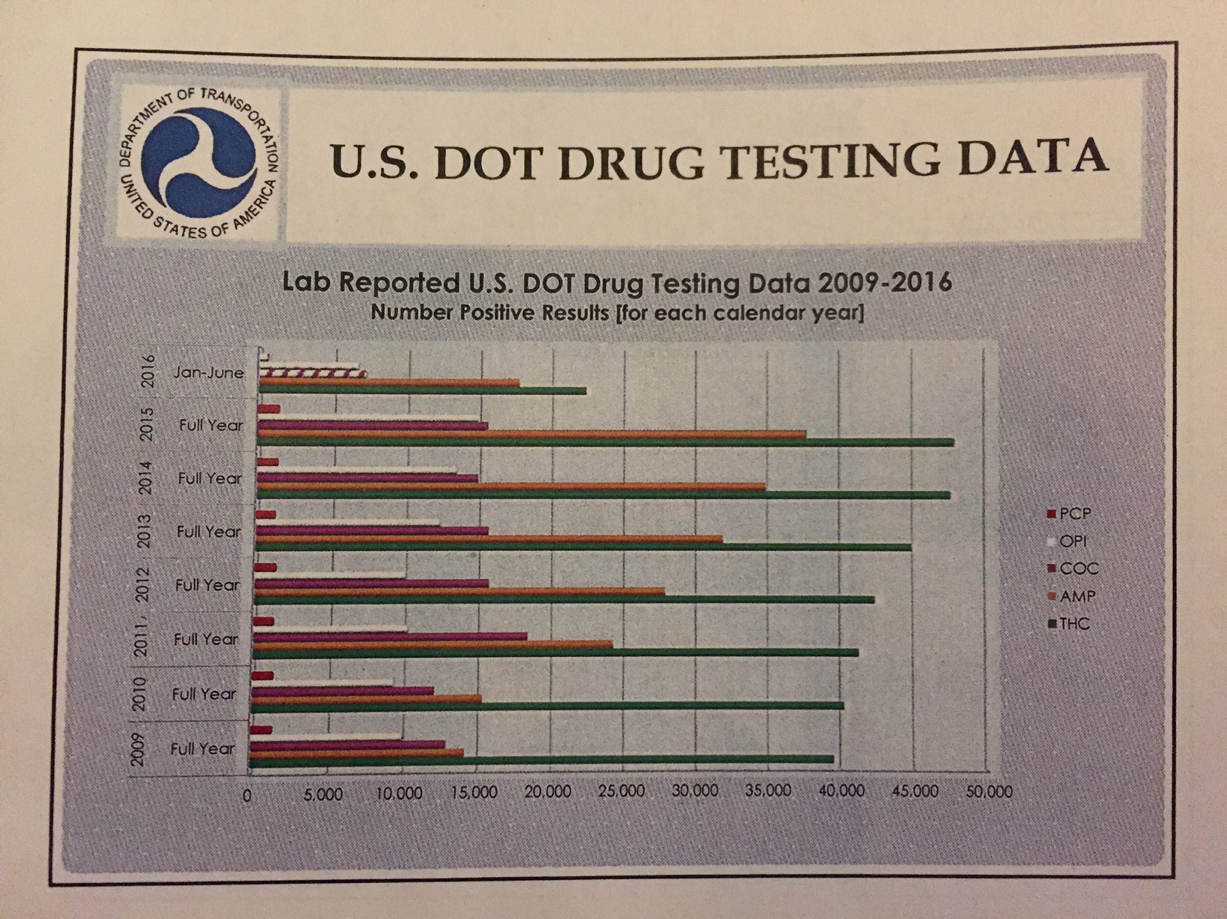
Current statistics

Slide 46
What drugs will be tested for?
Marijuana remains (for now) a Schedule I drug
MDEA is being removed from list
Opioids are being added:
hydrocodone, hydromorphone, oxycodone, oxymorphone

Slide 47
Practically…
With the addition of four opioids, the number of “positive” lab results will dramatically increase, as will the work of MROs to confirm these results

Slide 48

Questions?

